Slide 1
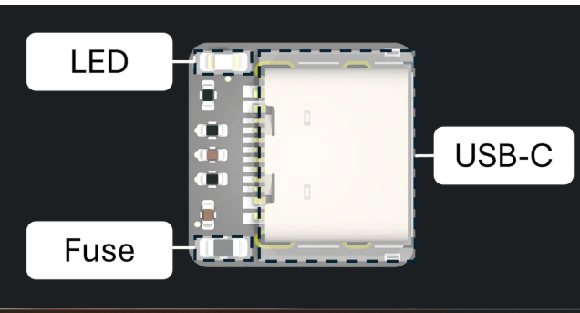
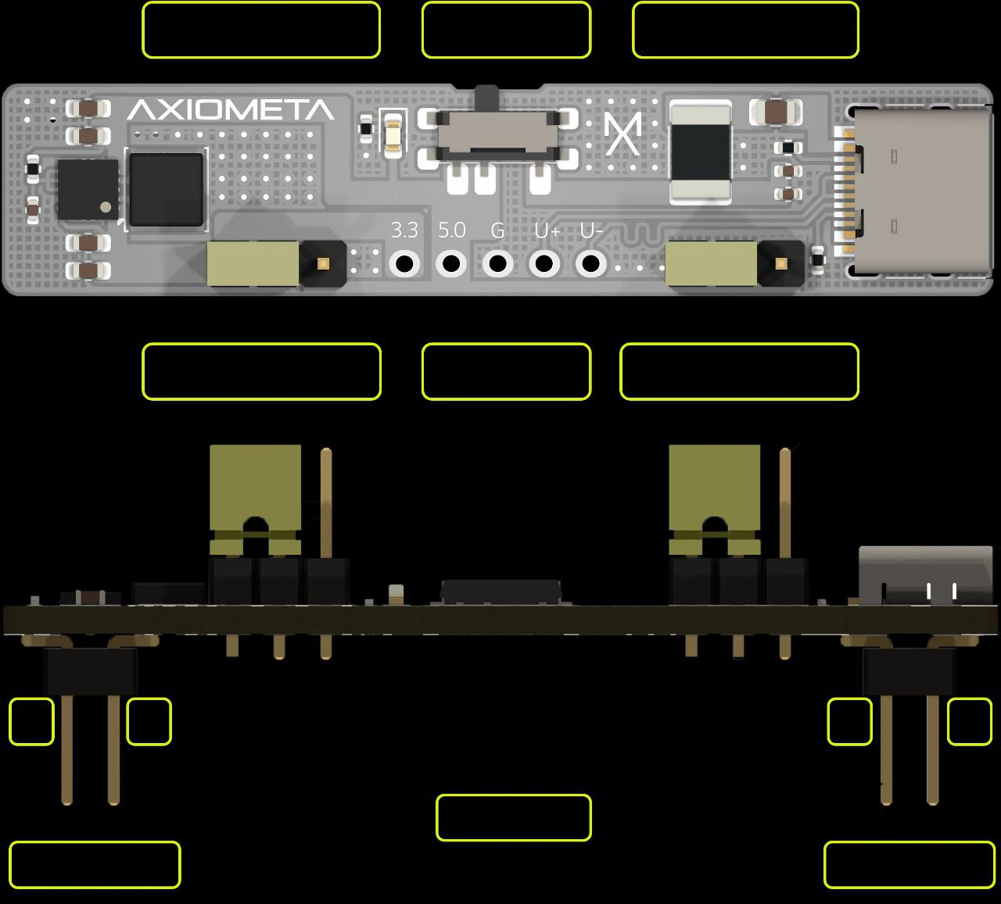
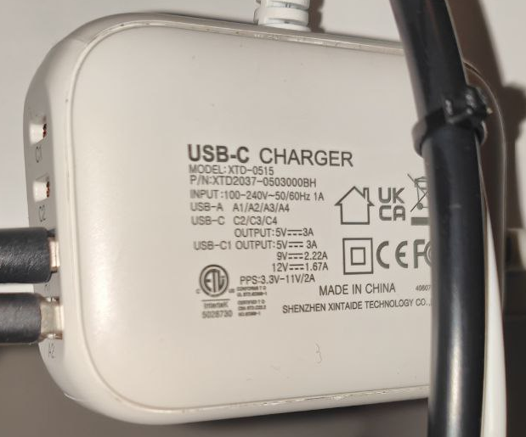
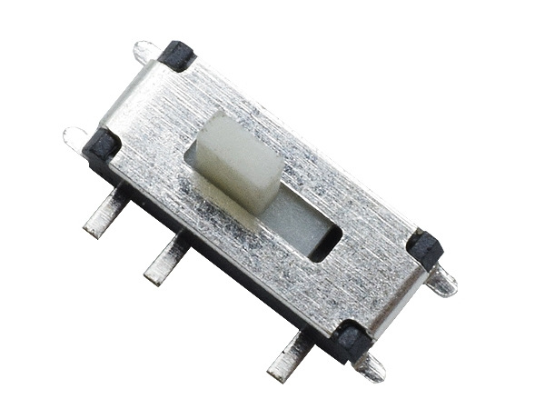
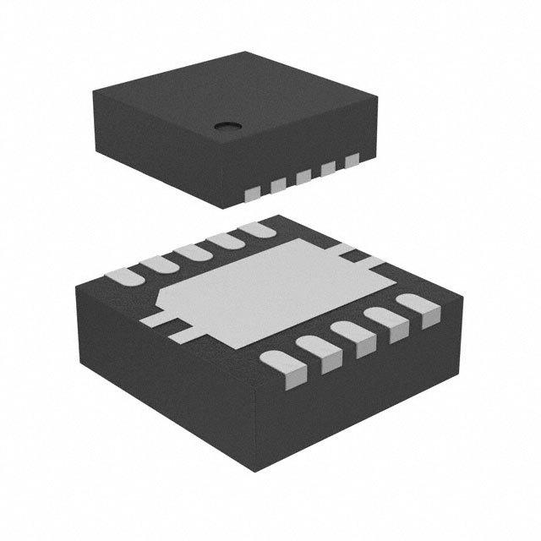
Select Voltage
5V or 3.3V
5V
5V or 3.3V
Input Supply
5V / 3A
Slide Switch
3.3V
Buck
Converter
(TPS63001)
Select Voltage
5V or 3.3V

